Slide 1
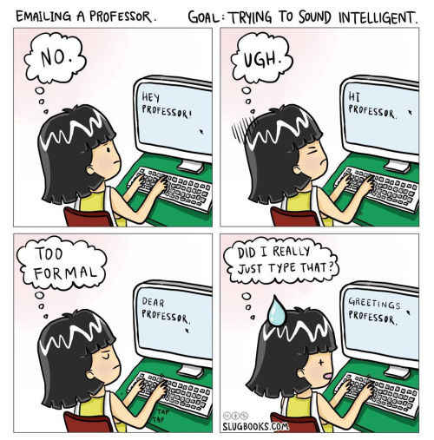
Communicating with Professors
Created by tutors at the IUP Writing Center
Notes:
FYI Tutor: Print out your own copy of the APA Sample Paper to reference during the workshop. Put the APA sample Paper with the examples on the WC Common U drive. Make sure the students open the adobe pdf. Reference the pdf during the workshop presentation. Do not switch screens between the powerpoint and the sample.

Slide 2
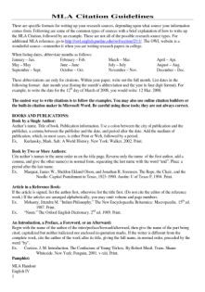
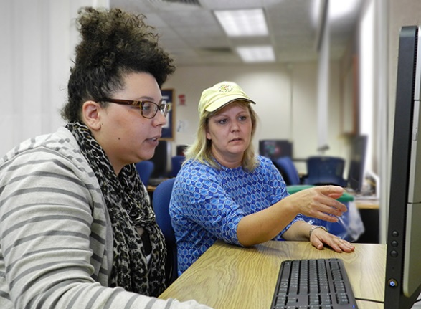


Welcome to the Writing Center!
We also have books and free handouts with information on writing strategies and formatting.
Writing Center tutors can help with every part of the writing process.
Prewriting
Drafting
Revising

Slide 3
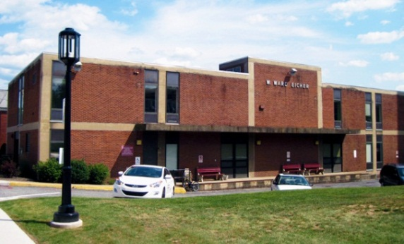
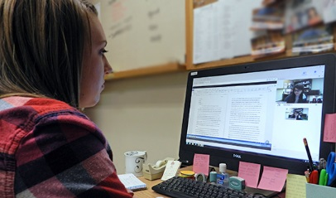
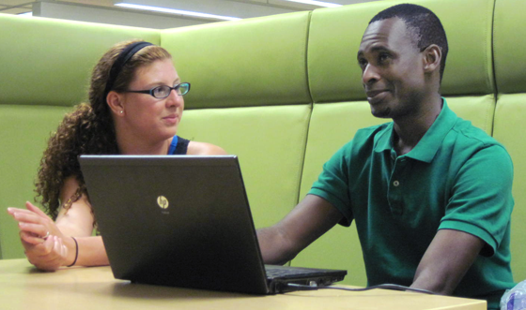
Get help online or on campus
218 Eicher Hall
Meet Us Online
Talk to a tutor through WebEx (like Skype).
Schedule an appointment at iup.edu/writingcenter
Stapleton Library
Monday - Thursday 9:00 am to 8:00 pm
Friday 9:00 am to 3:00 pm
Monday - Thursday 8:00 pm to 11:00 pm
Sunday 5:00 pm to 10:00 pm

Slide 4
Let’s take a poll…
Notes:
Tell the students that you’ll be giving them three different scenarios that they’ll probably face in their college careers.
They don’t have to answer them out loud or discuss, but they should consider what they would do in each case. Then tell them you’ll return to these questions later.

Slide 5
What would you do?
The syllabus lists an assignment due soon, but your professor hasn’t mentioned it in class. Would you...
Do nothing and hope she forgets
Raise your hand during class and ask
Email your professor
Just do the assignment anyway
Notes:
Read the scenario to them and the options. They should just think about what they would do, not answer or discuss yet.

Slide 6
What would you do?
You have an important job interview scheduled at the same time as your next English 101 class. Would you…
Skip class. You’re allowed to miss a few classes.
Email your professor before class to let her know you won’t be there.
Ask your professor at the beginning of the next class, “Did I miss anything?”
Try to reschedule the interview for another time
Notes:
Read the scenario to them and the options. They should just think about what they would do, not answer or discuss yet.

Slide 7
What would you do?
You’ve been sick and missed two classes in a row. You know there’s an assignment due on the day you’ll be back. Would you…
Do the assignment while you’re sick and turn it in on the listed due date
Email your professor before the next class and ask whether you should do the assignment
Go to the next class and ask your professor when she wants the assignment
Notes:
Read the scenario to them and the options. They should just think about what they would do, not answer or discuss yet.

Slide 8
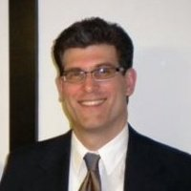
“The #1 thing is just that students communicate with professors at all, by any means. Too often I find that students don't ask me questions, don't stop by, don't respond to my emails, etc. Students who make an effort to do this almost always do better.”
Professors want you
to talk to them!
Dr. Matt Baumer, Music
Notes:
Explain that college is different from high school – professors may have more students and won’t hold students’ hands as much. They’re interested in helping their students, though, so there’s no reason to be hesitant about talking to them. Encourage students to visit professors during their office hours, and note that ALL profs have office hours. Also, students should not be put off or discouraged if a professor seems too busy to talk.

Slide 9
Effective communication
Helps you with course content. You can clarify course policies and assignments when you need to.
Helps you establish relationships with professors. They can provide guidance in your major and be a resource after graduation.
Prepares you for communicating in a work environment.

Slide 10
Getting in touch
In person
Before or after class
Office hours
Scheduled appointment
Electronically
Phone
Email
Notes:
Point out that professors have various preferences. Some rarely answer email, some answer promptly. Figure out what works and be flexible.
Some professors might give out their cell phone number, so you might ask the students whether they would feel comfortable texting their professor. When would they be comfortable/when wouldn’t they be?

Slide 11
Communicating in person
Notes:
Point: professors have different preferences. Students should find the way that works.
When you talk about email/phone, mention that Facebook/texting are popular ways for students to communicate, but many professors won’t give out their cell number to students (and if they do, most don’t text). This may change as these become more popular communication tools, but for now it’s best to email/call.

Slide 12
In person
Before / after class
Best for quick questions
Not appropriate for discussing grades
Office hours
Listed on the syllabus
Acceptable to drop in
Best for questions, discussion about class work or grades
Scheduled appointment
Set up via email or before/after class
Email ahead if you can’t make it
Notes:
After class, they should always make sure the professor has a few minutes. Just like a student might have another class starting in 15 minutes, a prof might too, so it’s not safe to assume you can have a lengthy conversation. Set up another time instead.
Also, university professors are required to have office hours. If you drop in and somebody’s already in there, just let the prof know you’re waiting outside.

Slide 13
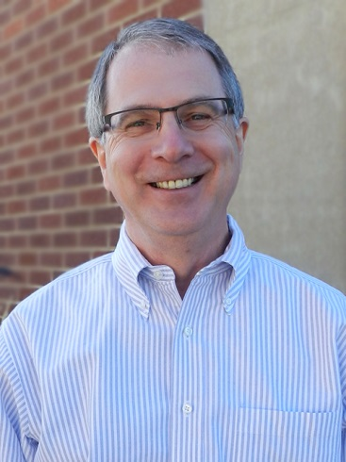
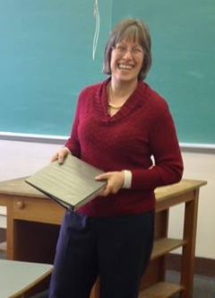
If you miss a class or come in late, speak to your professor about it briefly at the next opportunity. Don’t just let it slide. She may have a paper to return to you or an announcement to pass along.
Don’t ask, “Did I miss anything?” Of course you missed something. You’re more likely to get a positive response if you say, “I’d like to make up whatever I missed. Can you tell me what I should do?”
Dr. Ben Rafoth English
Dr. Tina Perdue
English

Slide 14
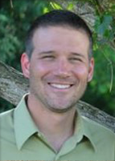
Talk to your advisor, too!
Most students’ horror stories come from naïve expectations about how much time they will get from academic advisors once the flood of human need washes over them during PIN number season. I urge freshmen to see advisors in the first two weeks so they can have a conversation about their goals and get some tips on how to do well in their major.
Kevin Berezansky
Honors College associate director
Notes:
Students might not know that their advisor is a professor in their department. They may or may not ever have their professor in class, but they should still have a good relationship with him/her.
Some advisors are very hands-on and will make themselves available for long conversations. Others want the student to do more legwork or just aren’t that helpful. If a student feels like her advisor isn’t helping her the way she needs, she can go to another professor or even request an official advisor change, but ideally she should try to have a good relationship with her advisor from the time she’s a freshman.

Slide 15
Communicating via email

Slide 16
When emailing, DO…
Read your syllabus first
Use a specific subject line (“override for JRNL 326” is better than “need class”)
Address your professor as “Professor” or “Dr.”
Be concise
Include your full name unless you have an email signature
Keep in mind: email is not confidential
Notes:
Examples of email not being confidential: email is hacked (it happens!), the professor has her email open when she’s projecting her screen to the entire class, etc.
In an unofficial poll we took, professor receive between 30 and 80 emails A DAY. So that’s what it’s important to be concise – they’re probably skimming your email rather than spending a lot of time reading.

Slide 17
When emailing, DON’T…
USE ALL CAPS or write like ur txtng
Send multiple emails if you don’t get a response right away
Send attachments other than .docx or PDF
Demand or assume anything. Always better to ask questions.
Attempt a sensitive discussion or dispute a grade
Notes:
Examples of email not being confidential: email is hacked (it happens!), the professor has her email open when she’s projecting her screen to the entire class, etc.
In an unofficial poll we took, professor receive between 30 and 80 emails A DAY. So that’s what it’s important to be concise – they’re probably skimming your email rather than spending a lot of time reading.

Slide 18
examples

Slide 19
Real student emails*
How could this student have communicated better?
"hey, professor. this is ___and I'm in your ___ class but have been busy working at my job for the past couple weeks so i have missed the first few classes. just wondering if there is anything important that i have missed."
*not IUP students, of course
Notes:
This activity is NOT about how the email should be written. Have them identify how the student is approaching this wrong.
Main problem here is the student assumes it’s okay to miss a couple weeks of class and wants to know if she missed anything. Have the class decide what this student should have done instead. Most likely an email is not going to cut it – she should talk to her professor in person and not assume that nothing happens in that person’s class!
These example emails are real emails from the Chronicle of Higher Education’s website: http://chronicle.com/forums/index.php/topic,29894.0.html

Slide 20
Real student emails*
How could this student have communicated better?
“I do not like math much at all.... I am a liberal arts type of person. ;) But I have been a 4.0 student all my life, and I want to contiue that way through collage. What I want to know is, what do I ahve to do to get a "A" or "B" in your class?”
*not IUP students, of course
Notes:
Have them identify how the student is approaching this wrong. Main problem here is the student assumes the grade is ‘awarded’ and not earned. Have the class decide what this student should have done instead. (Probably not something you want to say to a prof, ever!)
These example emails are real emails from the Chronicle of Higher Education’s website: http://chronicle.com/forums/index.php/topic,29894.0.html

Slide 21
Real student emails*
How could this student have communicated better with her professor?
I am so sorry I didn't talk to you about this earlier, but I have yet to receive the essay topic for the mid term. I also don't know when it is due. I have been in a huge fiasco with the school pertaining to my enrollment/academic status. I ended up having to miss class last wednesday in order to fill out and submit some forms that had just come to my attention.
*not IUP students, of course
Notes:
Have them identify how the student is approaching this wrong. Main problem here is the student is cramming too many issues into one email: no topic, doesn’t know the due date, missed class. Have the class decide what this student should have done instead. Best solution is probably to email the prof/come early to class and set up a time to meet outside of class.

Slide 22
What would you do?
Pick ONE scenario and discuss what you would do with the person sitting next to you. Be ready to share your plan with the group.
Scenario 1: The syllabus lists an assignment due soon, but your professor hasn’t mentioned it in class.
Scenario 2: You have an important job interview scheduled at the same time as your next English 101 class.
Scenario 3: You’ve been sick and missed two classes in a row. You know there’s an assignment due on the day you’ll be back.
Notes:
Now we’re back to the same issues from earlier, but there are no options. Have them talk in pairs and then go by scenario. Have everyone who took Scenario 1 share what they would do.
Then, modify each scenario to see what they would do. For example, follow up #1 with “What if you missed the past two classes and you’re not sure if the professor mentioned it in class?”
Change up #2 to be something more trivial, like “What if you want to go home on a Friday and your ride leaves the same time as class?” Change up #3 to be a group presentation instead of a basic assignment.

Slide 23
Get help online or on campus
218 Eicher Hall
Meet Us Online
Talk to a tutor through WebEx (like Skype).
Schedule an appointment at iup.edu/writingcenter
Stapleton Library
Monday - Thursday 9:00 am to 8:00 pm
Friday 9:00 am to 3:00 pm
Monday - Thursday 8:00 pm to 11:00 pm
Sunday 5:00 pm to 10:00 pm

Slide 24
Copy and paste this URL into a browser to take a quick survey on today’s workshop:
http://bitly.com/WCWorkshopSurvey

