Slide 1
Proofreading: THE FINAL TOUCH
Created by tutors at the IUP Writing Center

Slide 2
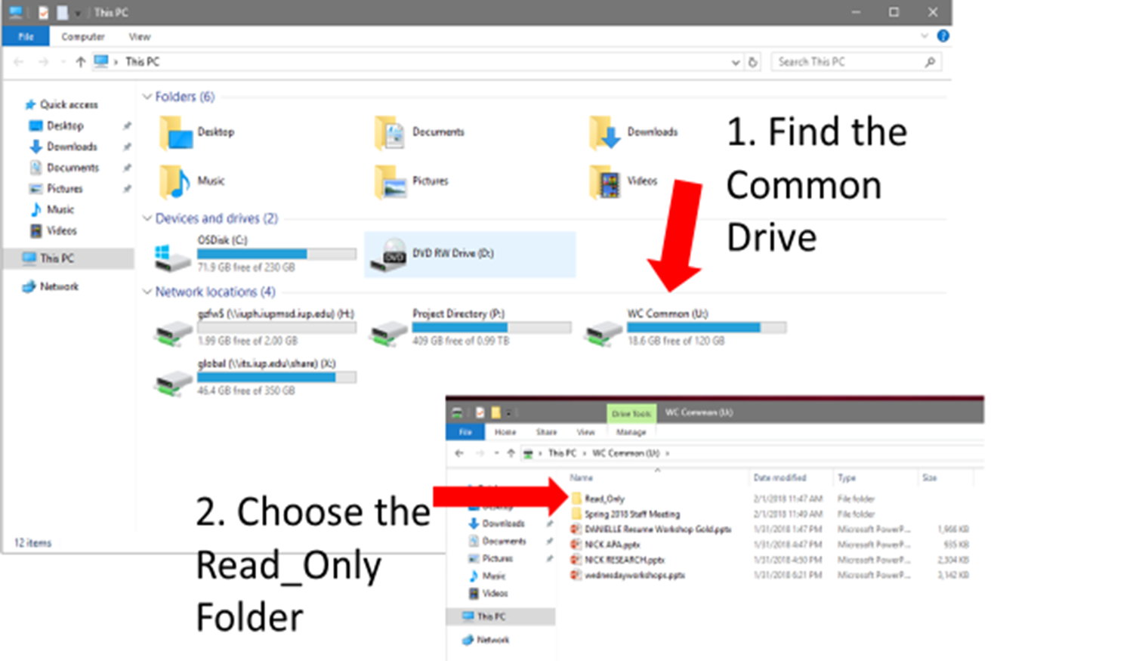

Slide 3
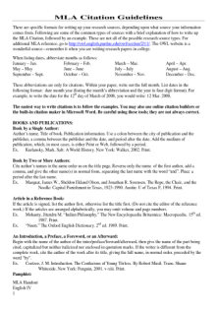
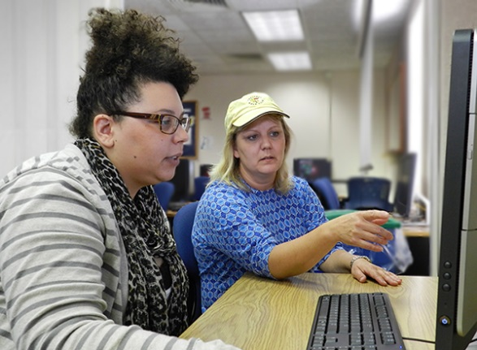
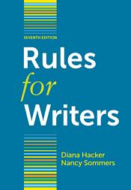
Welcome to the Writing Center!
We also have books and free handouts with information on writing strategies and formatting.
Writing Center tutors can help with every part of the writing process.
Prewriting
Drafting
Revising

Slide 4
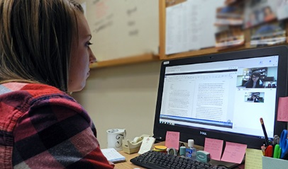
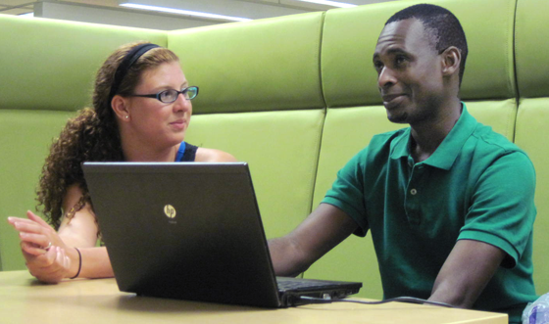
Get help online or on campus
218 Eicher Hall
Meet Us Online
Talk to a tutor through WebEx (like Skype).
Schedule an appointment at iup.edu/writingcenter
Stapleton Library
Monday - Thursday 9:00 am to 8:00 pm
Friday 9:00 am to 3:00 pm
Monday - Thursday 8:00 pm to 11:00 pm
Sunday 5:00 pm to 10:00 pm

Slide 5
Today you’ll learn…
How proofreading fits into the writing process
A few strategies for spotting your own mistakes
Common grammatical problems and how to fix them

Slide 6
Let’s first review the writing process.

Slide 7
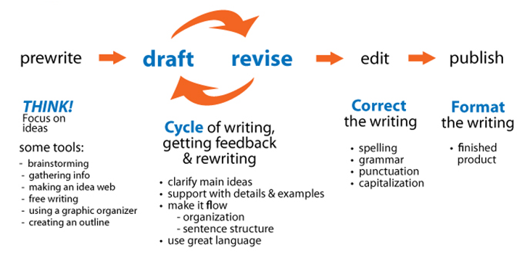
Notes:
Let’s begin by putting proofreading into proper perspective. Proofreading is the last step in the revising process, and therefore the last thing you do before you submit your paper. But think about this for a moment: What good is proofreading if a paper is not well-planned, carefully drafted, and thoroughly revised? In other words, proofreading is important, but it’s not the only thing, and not even the most important things.

Slide 8
Step 1: Prewrite
Understand the assignment
Brainstorm or free write
Create an idea map/web
Choose a topic
Begin researching
Outline main ideas
Notes:
So before we talk more about proofreading, let’s take a moment and consider what comes before it. When you plan, you consider your options, choose a topic, and conduct research. It’s important to get your ideas on paper right from the start. You may brainstorm, make a web or bubble diagram, create an outline, or list ideas. Think with a pen or keyboard!

Slide 9
Step 2: Draft
Record your ideas
Consider organization
Develop main ideas
Create an intro and conclusion
Notes:
During the drafting phase, you’ll put your ideas on paper in sentences and paragraphs, but try not to get bogged down with style, grammar, or punctuation. Keep writing your ideas for as long as you can….. and then write for five minutes more!

Slide 10
Step 3: Revise
Wait, what’s the difference between revising and proofreading?
Notes:
Anyone: What do you think is the difference between revising and proofreading?

Slide 11
Step 3: Revise
Refine the organization
Sharpen the introduction and thesis statement
Add details and examples
Notes:
When revising, try to avoid becoming distracted by fixing spelling or grammar mistakes. Save these for later on. Instead, review what you’ve written and try to make the paper stronger by adding new details and examples, clarifying points that need more support and checking the tone of your paper.

Slide 12
If you follow Steps 1-3, you’ll have a well-organized paper with ideas that are expressed clearly.
Now it’s time to clean it up.
Notes:
When revising, try to avoid fixing spelling or grammar mistakes. Save these for later on. Instead, review what you’ve written and try to make the paper stronger by adding new details and examples, clarifying points that need more support and checking the tone of your paper.

Slide 13
Step 4: Proofread
Polish your essay
Rewrite awkward sentences
Correct grammatical and mechanical errors
Fix spelling mistakes
Notes:
When it comes time for proofreading, work on sentence and word errors. You might need to fix word choice, run-ons, fragments, missing words, and subject-verb agreement. We’ll talk more about these in a little bit.

Slide 14
Today you’ll learn…
How proofreading fits into the writing process
A few strategies for spotting your own mistakes
Common grammatical problems and how to fix them

Slide 15
Need some help?
Work with a tutor
One-on-one peer tutoring
It’s a learning opportunity
Work by yourself
Use reference manuals
Use Writing Center handouts
Use the Internet (Purdue OWL)
Notes:
Have you ever given a paper to a friend or family member and asked them to look it over for you? Did they talk with you about it, or did they just tell you what to change or correct? Which kind of feedback do you prefer?

Slide 16
A few strategies
Work with someone
Read out loud
Isolate each line
S l o w d o w n …
Notes:
There are some skills that you can practice that help you become a better writer.
The most important thing is, slow down! Read at what seems like an incredibly slow pace. Remember, you’re reading for errors, not content.
Second, consider working with someone else. A proofreading buddy could help relieve the frustration of poring through your own work.
Third, read aloud to yourself or to a friend. This helps you find mistakes, and your partner might notice them better when they are read aloud, too.
Finally, isolate your text. In other words, try to look at only one line at a time by covering up all but one line. Or, read your paper backwards, sentence by sentence.

Slide 17
More strategies
Read for one kind of problem at a time
Assume you’ve made mistakes. Everyone does!
Notes:
1) Read for problems: Instead of reading for ideas, read for errors. Keep specific problems in mind such as comma errors and verb forms. If there are errors you tend to make often, look for those.
2) Assume mistakes: Read every sentence to find its problem. If you’re expecting errors, you’ll find more.
3) Read again: You can never find all of the mistakes the first time. Read again, this time looking for a different problem.

Slide 18
Don’t always trust your ears!
Look for colloquialisms
Look for verb form errors
Remember your frequent mistakes
Knowing what you’re looking for is half the battle!
Notes:
What’s a colloquialism? Some regional speech habits are hard to identify when they seem so natural. For example, saying the car needs washed is ok for casual conversation. But in writing, it should be needs to be washed .
Familiarize yourself with common grammar rules and try to learn about the mistakes you commonly make.

Slide 19
Today you’ll learn…
How proofreading fits into the writing process
A few strategies for spotting your own mistakes
Common grammatical problems and how to fix them

Slide 20
Common grammatical problems
What kinds of mistakes do you tend to overlook?
Notes:
The following slides show a few common problems.
Pay particular attention to those that you recognize from your own papers.
If you don’t know what your common mistakes are, re-read your graded essays and keep a list in a notebook.

Slide 21
Sentence fragments
Technology allows people today to fill prescription medications at drug stores around the world. And receive immediate medical help when needed.
Notes:
Many people overlook fragment sentences in their writing, like this one. Is this fragment wrong? Not necessarily. (Discuss).
So the point is that sometimes rules are broken for a reason, and sometimes not. It’s the “sometimes not” that you need to be concerned about!

Slide 22
Sentence fragments
Strategy: Connect the fragment to the previous sentence.
Technology allows people today to fill prescription medications at pharmacies around the world and receive immediate medical help when needed.

Slide 23
Can you identify the error?
In his article, Dr. Lewis writes about an old patient that passed away recently, by the time he first met her, she had already been through her share of illness and surgeries.
Notes:
How would you describe the error in this sentence?
(This is a comma-splice, and to correct it, put a semi-colon or a period after the word recently)

Slide 24
Run-on sentences
Strategy: Even if the ideas fit together, don’t join two sentences with just a comma. Separate the sentences or use a semicolon or a comma + conjunction instead.
In his article, Dr. Lewis writes about an old patient that passed away recently; by the time he first met her, she had already been through her share of illness and surgeries.
In his article, Dr. Lewis writes about an old patient that passed away recently. By the time he first met her, she had already been through her share of illness and surgeries.

Slide 25
Agreement
Strategy: Look for number and pronoun agreement.
Happiness has a more positive effect on a person’s body than the most expensive treatment for them.

Slide 26
Agreement
Happiness has a more positive effect on a person’s body than the most expensive treatment for him or her.
OR
Happiness has a more positive effect on a person’s body than the most expensive treatment.
Notes:
Note that there’s always more than one way to fix a mistake.

Slide 27
Apostrophes & possessive pronouns
The turtle fell on it’s back.
The turtle fell on its back.
Which one is correct and why?
Notes:
Why? Because possessive pronouns don’t use apostrophes.
Its shows ownership, while it’s is a contraction of it is.
Another example: Whose shows ownership, while who’s is a contraction of who is.

Slide 28
Apostrophes & possessive pronouns
Who’s dog is that?
Whose dog is that?
Which one is correct and why?
Notes:
Why? Because possessive pronouns don’t use apostrophes.
Its shows ownership, while it’s is a contraction of it is.
Another example: Whose shows ownership, while who’s is a contraction of who is.

Slide 29
Citations & punctuation
Incorrect:
Dr. Lerner wrote “Martha was a bright and vibrant woman (Lewis 15)
Revised:
Dr. Lerner wrote, “Martha was a bright and vibrant woman” (Lewis 15).
Notes:
Include all quoted text within quotation marks. Don’t forget to mark the end of the quotation with closed quotes.
Follow the citation with a period.

Slide 30
Test your skills
Work with the person next to you to proofread the following:
After he designed human-powered planes, Paul MacCready, a prize-winning inventor goes on to design a solar-powered plane, however McCready realized that Solar cells make sense as an energy souce. Conserving energy, limiting pollutants, and the shift away from fossil fuels were important to him. MacCready, who had long sympathized with environmental concerns, hoped to demonstrate that solar power will play an important part in the worlds energy future.
Notes:
To follow this link, you need to go to the Word document that accompanies this PowerPoint.

Slide 31
What did you find?
The first few are bolded. What others did you spot?
After he designed human-powered planes, Paul MacCready, a prize-winning inventor, went on to design a solar-powered plane. However, McCready realized that Solar cells make sense as an energy souce. Conserving energy, limiting pollutants, and the shift away from fossil fuels were important to him. MacCready, who had long sympathized with environmental concerns, hoped to demonstrate that solar power will play an important part in the worlds energy future.
Notes:
To follow this link, you need to go to the Word document that accompanies this PowerPoint.

Slide 32
Need more help with grammar?
Check a grammar book such as Diana Hacker’s A Writer’s Reference.
Ask a Writing Center tutor!
Notes:
A Writer’s Reference or any other grammar book can be an easy-to-use resource. We have a variety of handbooks here that you can look at.
Knowing how to use a grammar book lessens frustration. Most indexes list page numbers for common errors. Also use the Purdue University OWL

Slide 33
Let’s recap what you learned
How does proofreading fit into the writing process?
What are some strategies you can use to spot your mistakes?
Can you name a grammatical problem and how to fix it?
Notes:
Tutors: Have a list of main take-away ideas ready, in case your students don’t respond. But give them time to think of responses.

Slide 34
Get help online or on campus
218 Eicher Hall
Meet Us Online
Talk to a tutor through WebEx (like Skype).
Schedule an appointment at iup.edu/writingcenter
Stapleton Library
Monday - Thursday 9:00 am to 8:00 pm
Friday 9:00 am to 3:00 pm
Monday - Thursday 8:00 pm to 11:00 pm
Sunday 5:00 pm to 10:00 pm

Slide 35
Copy and paste this URL into a browser to take a quick survey on today’s workshop: http://bitly.com/WCWorkshopSurvey

